Slide 1
Searching and Sorting Techniques
Mrs. Sonali V. Shinge

Slide 2
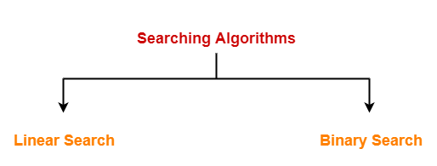
Searching
Searching is the process of finding some particular element in the list.
If the element is present in the list, then the process is called successful and the process returns the location of that element, otherwise the search is called unsuccessful.

Slide 3
Linear Search
Linear search is a very simple search algorithm.
A sequential search is made over all items one by one.
Every item is checked and if a match is found then that particular item is returned, otherwise the search continues till the end of the data collection.
Linear search work on unsorted list.

Slide 4
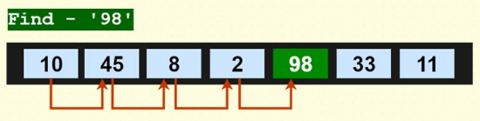
Example
Compare target element with first element of the array.
If not found increment the index value and compare with next element.

Slide 5
Algorithm
LINEAR_SEARCH(A, N, VAL)
Step 1: [INITIALIZE] SET POS = -1
Step 2: [INITIALIZE] SET i = 1
Step 3: Repeat Step 4 while i<=N
Step 4: IF A[i] = VAL SET POS = i PRINT POS Go to Step 6 [END OF IF] SET i = i + 1 [END OF LOOP]
Step 5: IF POS = -1 PRINT " VALUE IS NOT PRESENTIN THE ARRAY " [END OF IF]
Step 6: EXIT

Slide 6
Complexity of algorithm
Complexity | Best Case | Average Case | Worst Case
Time | O(1) | O(n) | O(n)
Space |  |  | O(1)

Slide 7
Binary Search
Binary search is the search technique which works efficiently on the sorted lists.
Binary search follows divide and conquer approach in which, the list is divided into two halves and the item is compared with the middle element of the list.
If the match is found then, the location of middle element is returned otherwise, we search into either of the halves depending upon the result produced through the match.

Slide 8
Algorithm
BINARY_SEARCH(A, lower_bound, upper_bound, VAL)
Step 1: [INITIALIZE] SET BEG = lower_bound END = upper_bound, POS = - 1
Step 2: Repeat Steps 3 and 4 while BEG <=END
Step 3: SET MID = (BEG + END)/2
Step 4: IF A[MID] = VAL SET POS = MID PRINT POS Go to Step 6 ELSE IF A[MID] > VAL SET END = MID - 1 ELSE SET BEG = MID + 1 [END OF IF] [END OF LOOP]
Step 5: IF POS = -1 PRINT "VALUE IS NOT PRESENT IN THE ARRAY" [END OF IF]
Step 6: EXIT

Slide 9

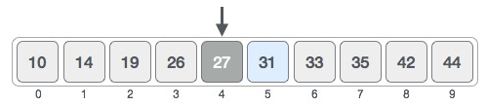
Example
Search element (target) : 31
Calculate mid
Compare target with mid
mid = low + (high - low) / 2

Slide 10

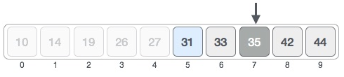
Contd…
change the low to mid + 1 and find the new mid value again.
low = mid + 1
mid = low + (high - low) / 2
Compare target with new mid value.

Slide 11
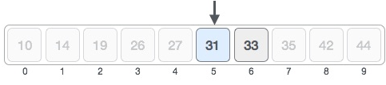

Contd…
calculate the mid again.
compare the value stored at location 5 with our target value. find that it is a match.

Slide 12
Complexity of algorithm
Complexity | Best Case | Average Case | Worst Case
Time | O(1) | O(log n) | O(log n)
Space |  |  | O(1)

Slide 13
Case study on
Sentinel Search
Fibonacci Search
Meta Binary search/One-sided binary search
Ternary Search
Jump Search
Interpolation Search
Exponential Search
Submit this case study on or before 28th Jan 2025

Slide 14
Sorting
Sorting is a process of ordering or placing a list of elements from a collection in some kind of order.
Sorting can be performed using several techniques or methods, as follows:
Bubble Sort
Insertion Sort
Selection Sort
Quick Sort
Heap Sort
Merge Sort
Radix Sort
Tim Sort

Slide 15
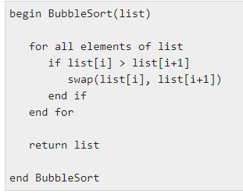
Bubble Sort
Bubble sorting algorithm is comparison-based algorithm in which each pair of adjacent elements is compared and the elements are swapped if they are not in order.

Slide 16
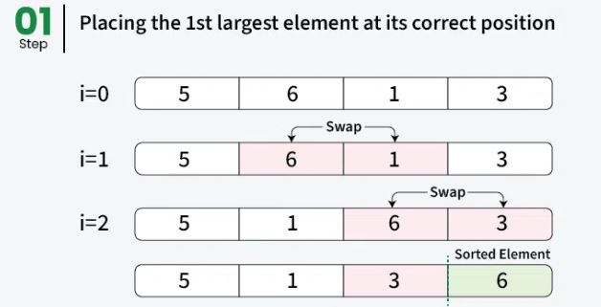

Slide 17
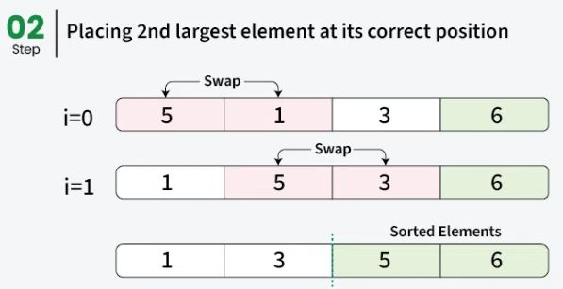

Slide 18
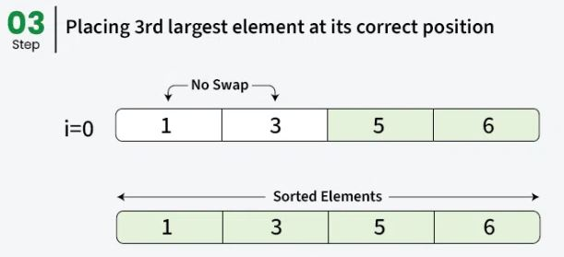

Slide 19
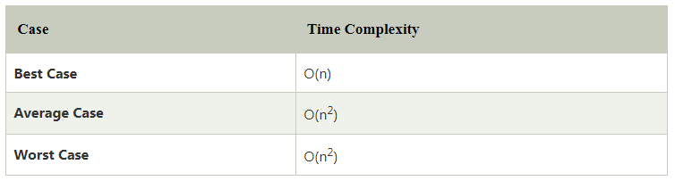
Contd…
This algorithm is not suitable for large data sets as its average and worst-case time complexity are quite high.
Advantages of Bubble Sort:
Bubble sort is easy to understand and implement.
It does not require any additional memory space.
It is a stable sorting algorithm, meaning that elements with the same key value maintain their relative order in the sorted output.
Disadvantages of Bubble Sort:
Bubble sort has a time complexity of O(n²) which makes it very slow for large data sets.
Bubble sort has almost no or limited real world applications. It is mostly used in academics to teach different ways of sorting.

Slide 20
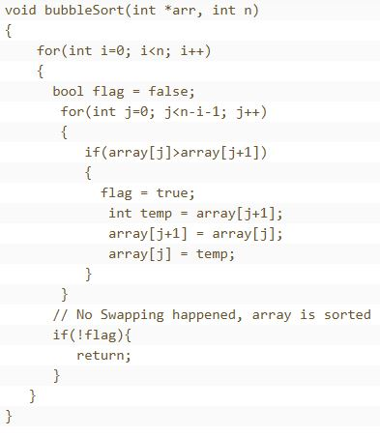
Algorithm for optimized bubble sort

Slide 21
Insertion Sort
Insertion sort is an in-place comparison-based sorting algorithm.
A sub-list is maintained which is always sorted.
An element which is to be inserted in the sorted sub-list, has to find its appropriate place and then it has to be inserted there.
The array is searched sequentially and unsorted items are moved and inserted into the sorted sub-list .
This algorithm is not suitable for large data sets as its average and worst case complexity are of Ο(n²), where n is the number of items.

Slide 22
Algorithm
Step 1 - If the element is the first element, assume that it is already sorted.
Return 1.
Step 2 - Pick the next element, and store it separately in a key.
Step 3 - Now, compare the key with all elements in the sorted array.
Step 4 - If the element in the sorted array is smaller than the current element, then move to the next element. Else, shift greater elements in the array towards the right.
Step 5 - Insert the value.
Step 6 - Repeat until the array is sorted.

Slide 23
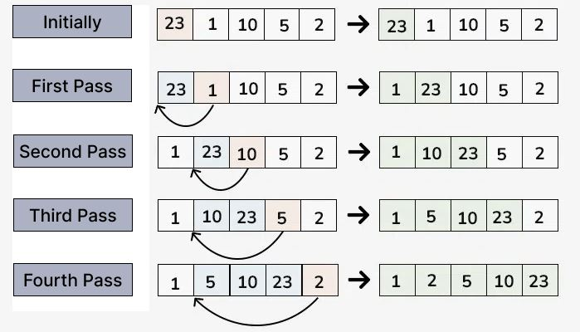

Slide 24
Pseudo Code
for(i=0;i<n-1;i++)
{
temp=a[i];
j=i-1;
while(j>=0 && a[j]>temp)
{
a[j+1]=a[j];
j--;
}
a[j+1]=temp;
}

Slide 25
Advantages of Insertion Sort:
Simple and easy to implement.
Stable sorting algorithm.
Efficient for small lists and nearly sorted lists.
Space-efficient as it is an in-place algorithm.
Adoptive. the number of inversions is directly proportional to number of swaps. For example, no swapping happens for a sorted array and it takes O(n) time only.
Disadvantages of Insertion Sort:
Inefficient for large lists.
Not as efficient as other sorting algorithms (e.g., merge sort, quick sort) for most cases.

Slide 26
Selection Sort
This sorting algorithm is an in-place comparison-based algorithm in which the list is divided into two parts, the sorted part at the left end and the unsorted part at the right end.
Initially, the sorted part is empty and the unsorted part is the entire list.
The smallest element is selected from the unsorted array and swapped with the leftmost element, and that element becomes a part of the sorted array.
This process continues moving unsorted array boundary by one element to the right.

Slide 27
Algorithm
Step 1: set min to 0
Step 2: search the minimum element in the list
Step 3: swap with the value at location min
Step 4: increment min point to next element
Step 5: repeat until list is sorted.
Complexity | Best Case | Average Case | Worst Case
Time | O(n²) | O(n²) | O(n²)
Space |  |  | O(1)

Slide 28
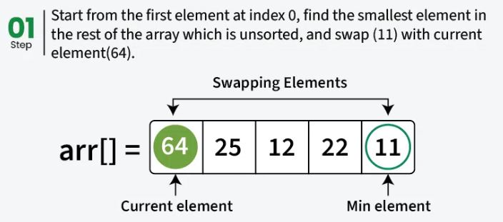
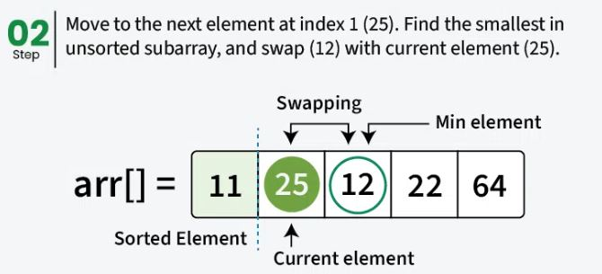

Slide 29
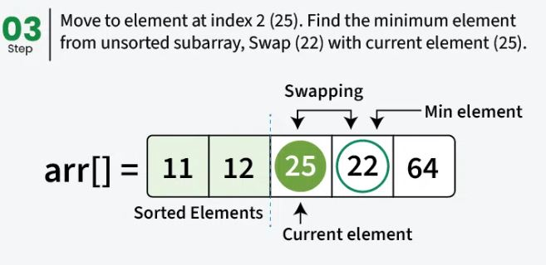
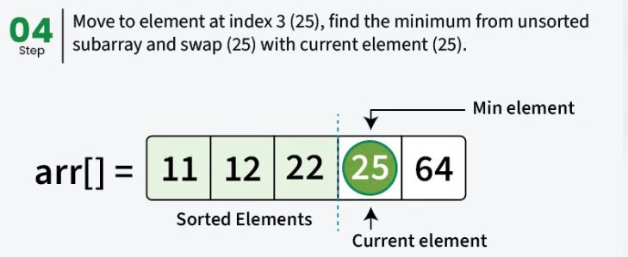

Slide 30
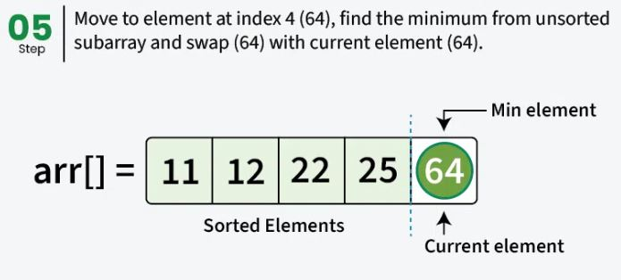
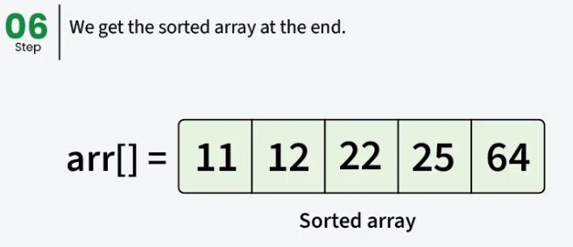

Slide 31
Pseudo code
For(i=0;i<n-1;i++)
{
int min=i;
for(j=i+1;j<n; j++)
{
if(a[j]<a[min])
{
min=j;
}
}
if(min!=i)
{
swap(a[i],a[min])
}
}

Slide 32
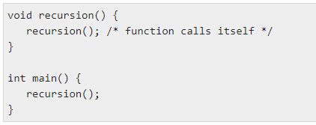
Recursion
Recursion is the process of repeating items in a self-similar way.
In programming languages, if a program allows you to call a function inside the same function, then it is called a recursive call of the function.

Slide 33
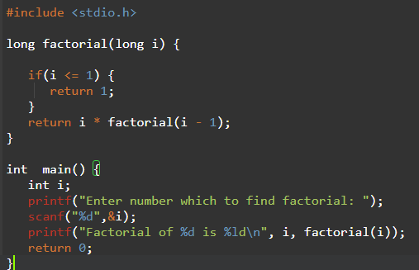
Example
Calculates the factorial of a given number using a recursive function.

Slide 34
Quick Sort
This algorithm follows the divide and conquer approach.
Divide and conquer is a technique of breaking down the algorithms into sub problems, then solving the sub problems, and combining the results back together to solve the original problem.
1. Divide: In Divide, first pick a pivot element. After that, partition or rearrange the array into two sub-arrays such that each element in the left sub-array is less than or equal to the pivot element and each element in the right sub-array is larger than the pivot element.
2. Conquer: Recursively, sort two sub arrays with Quick sort.
3. Combine: Combine the already sorted array.

Slide 35
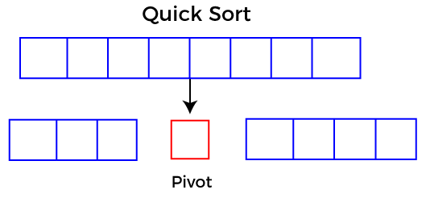
Complexity | Best Case | Average Case | Worst Case
Time | O(n log n) | O(n log n) | O(n²)
Space |  |  | O(n)

Slide 36
Algorithm
Step 1 - Consider the first element of the list as pivot (i.e., Element at first position in the list).
Step 2 - Define two variables i and j. Set i and j to first and last elements of the list respectively.
Step 3 - Increment i until list[i] > pivot then stop.
Step 4 - Decrement j until list[j] < pivot then stop.
Step 5 - If i < j then exchange list[i] and list[j].
Step 6 - Repeat steps 3,4 & 5 until i > j.
Step 7 - Exchange the pivot element with list[j] element.

Slide 37
Pseudo Code
Partition(a, lb, ub)
{
Pivot=a[lb];
Start=lb;
End=ub;
While(lb<ub)
{
While(a[start]<=pivot)
{
Start++;
}
While(a[end]>pivot)
{
End--;
}
If(start<end)
{
Swap(a[start],a[end]);
}
}
Swap(a[lb],a[end]);
return end;
}

Slide 38
Contd...
Quicksort(a, lb, ub)
{
If(lb < ub)
{
Loc=partition(a, lb, ub);
Quicksort(a,lb,loc-1);
Quicksort(a,loc+1,ub);
}
}

Slide 39
Merge Sort
Like Quick Sort, Merge Sort is a Divide and Conquer algorithm.
It divides the input array into two halves, calls itself for the two halves, and then merges the two sorted halves.
Complexity | Best Case | Average Case | Worst Case
Time | O(n log n) | O(n log n) | O(n log n)
Space |  |  | O(n)

Slide 40
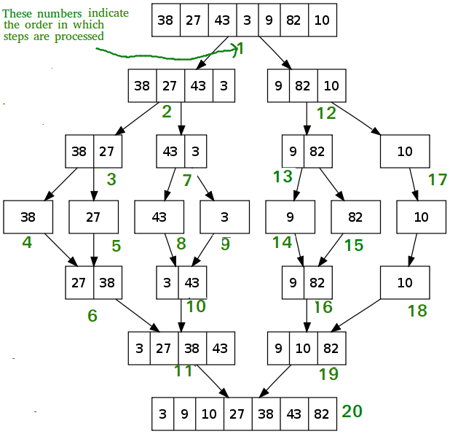

Slide 41
Algorithm
MergeSort (arr[], l, r)
If r > l
Step 1. Find the middle point to divide the array into two halves: middle m = l+ (r-l)/2
Step 2. Call MergeSort for first half: Call MergeSort( arr, l, m)
Step 3. Call MergeSort for second half: Call MergeSort( arr, m+1, r)
Step 4. Merge the two halves sorted in step 2 and 3: Call Merge( arr, l, m, r)

Slide 42
Pseudo Code
MergeSort (a, lb, ub)
{
if(lb< ub)
{
mid=(lb + ub)/2;
MergeSort(a, lb, mid);
MergeSort(a,mid+1,ub);
Merge(a, lb, mid, ub);
}
}

Slide 43
Merge(a, l b, mid, ub)
{
i=lb;
j=mid+1;
k=lb;
while(i<=mid && j<=ub)
{
if(a[i]<=a[j])
{
b[k]=a[i];
i++;
}
else
{
b[k]=a[j];
j++;
}
k++;
}

Slide 44
if(i>mid)
{
while(j<=ub)
{
b[k]=a[j];
j++;
k++;
} }
Else
{
while(i<=mid)
{
b[k]=a[i];
i++;
k++;
} }
For(k=lb; k<ub; k++)
{ a[k]=b[k];
}
}

Slide 45
Counting sort
Sorting according to keys.
Counting the elements having distinct key values.
Pseudo code:-
CountSort (a, n, k)
{
int count[k+1]={0}; int b[n];
for(i=0;i<n;i++)
{
++count[a[i]]; }
for(i=1;i<=k;i++)
{
count[i]=count[i]+count[i-1]; }
for(i=n-1;i>=0;i--)
{
b[--count[a[i]]]=a[i];
}
for(i=0;i<n;i++)
{
a[i]=b[i]; }
}

Slide 46
Contd…
Complexity:- O(n)
Drawback:-
Can not work on negative values.
k upper bound is k=O(n)

Slide 47
Radix sort
RadixSort (a, n)
{
int max=getMax(a, n)
for(pos=1;max/pos>0;pos*10)
{
CountSort(a, n, pos)
}
}

Slide 48
CountSort(a, n, pos)
{
count[10]={0};
for(i=0; i<n; i++)
{
++count[(a[i]/pos)%10];
}
for(i=1;i<=10;i++)
{
count[i]=count[i]+count[i-1];
}
for(i=n-1;i>=0;i--)
{
b[--count[(a[i]/pos)%10]]=a[i];
}
for(i=0;I<n;i++)
{
a[i]=b[i];
}
}

Slide 49
Hashing
Hashing is a technique used in data structures that efficiently stores and retrieves data in a way that allows for quick access.
Hashing involves mapping data to a specific index in a hash table (an array of items) using a hash function that enables fast retrieval of information based on its key.
The great thing about hashing is, it can achieve all three operations (search, insert and delete) in O(1) time on average.
Hashing is mainly used to implement a set of distinct items and dictionaries (key value pairs).

Slide 50
Components of Hashing
There are majorly three components of hashing:
Key: A Key can be anything string or integer which is fed as input in the hash function the technique that determines an index or location for storage of an item in a data structure.
Hash Function: Receives the input key and returns the index of an element in an array called a hash table. The index is known as the hash index .
Hash Table: Hash table is typically an array of lists. It stores values corresponding to the keys. Hash stores the data in an associative manner in an array where each data value has its own unique index.

Slide 51
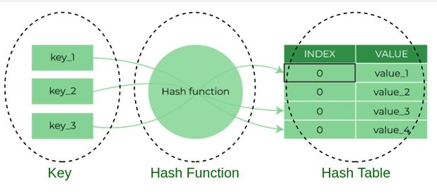

Slide 52
Hash function
A hash function creates a mapping from an input key to an index in hash table, this is done through the use of mathematical formulas known as hash functions.
Types of Hash functions
Division Method
Mid Square Method
Folding Method
Multiplication Method

Slide 53
Division Method
The division method involves dividing the key by a prime number and using the remainder as the hash value.
h(k)=k mod m
Where k is the key and m is a prime number.
Advantages:
Simple to implement.
Works well when m is a prime number.
Disadvantages:
Poor distribution if m is not chosen wisely.

Slide 54
Multiplication Method
In the multiplication method, a constant 𝐴A (0 < A < 1) is used to multiply the key. The fractional part of the product is then multiplied by 𝑚m to get the hash value.
h(k)=⌊m(kAmod1)⌋
Where ⌊ ⌋ denotes the floor function.
Advantages:
Less sensitive to the choice of m.
Disadvantages:
More complex than the division method.

Slide 55
Mid-Square Method
In the mid-square method, the key is squared, and the middle digits of the result are taken as the hash value.
Steps:
Square the key.
Extract the middle digits of the squared value.
Advantages:
Produces a good distribution of hash values.
Disadvantages:
May require more computational effort.

Slide 56
Folding Method
The folding method involves dividing the key into equal parts, summing the parts, and then taking the modulo with respect to 𝑚m.
Steps:
Divide the key into parts.
Sum the parts.
Take the modulo m of the sum.
Advantages:
Simple and easy to implement.
Disadvantages:
Depends on the choice of partitioning scheme.

Slide 57
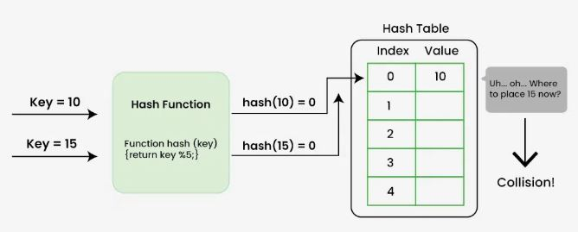
Collision

Slide 58
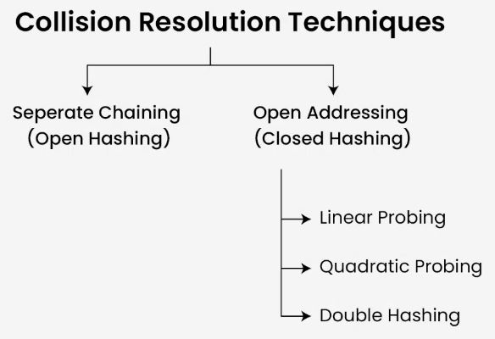
handle Collisions
There are mainly two methods to handle collision:
Open hashing/separate chaining/closed addressing
Open addressing/closed hashing

Slide 59
Open hashing/separate chaining/closed addressing
A typical collision handling technique called "separate chaining" links components with the same hash using linked lists. It is also known as closed addressing and employs arrays of linked lists to successfully prevent hash collisions.
Example: Let us consider a simple hash function as “key mod 5” and a sequence of keys as 12, 22, 15, 25

Slide 60
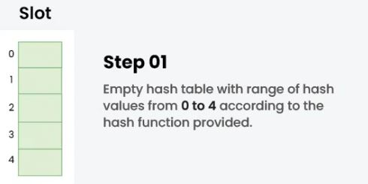
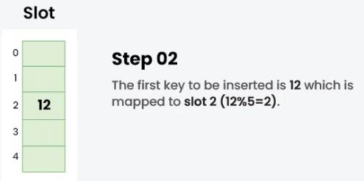
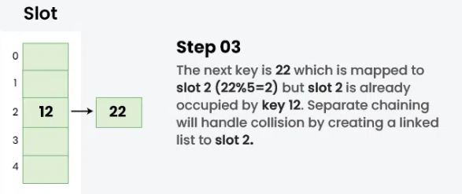

Slide 61
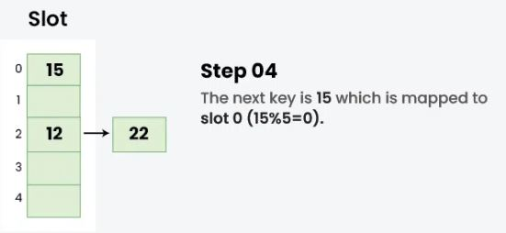
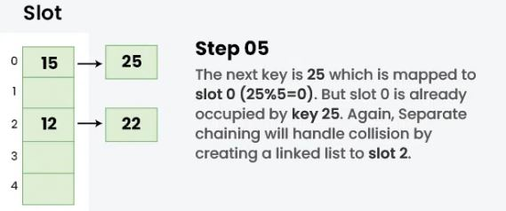

Slide 62
Closed hashing (Open addressing)
Instead of using linked lists, open addressing stores each entry in the array itself.
The hash value is not used to locate objects.
To insert, it first verifies the array beginning from the hashed index and then searches for an empty slot using probing sequences.
The probe sequence, with changing gaps between subsequent probes, is the process of progressing through entries.
There are three methods for dealing with collisions in closed hashing.

Slide 63
Linear Probing
Linear probing includes inspecting the hash table sequentially from the very beginning.
If the site requested is already occupied, a different one is searched. The distance between probes in linear probing is typically fixed (often set to a value of 1).
index = key % hashTableSize
index = ( hash(n) % T)
(hash(n) + 1) % T
(hash(n) + 2) % T
(hash(n) + 3) % T … and so on.

Slide 64
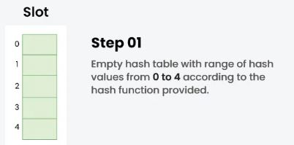
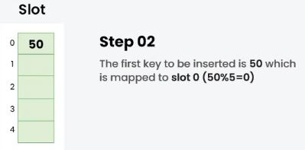
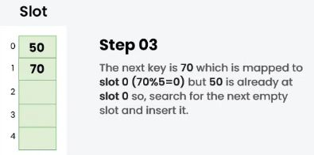
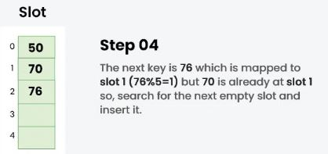
Example: Let us consider a simple hash function as “key mod 5” and a sequence of keys that are to be inserted are 50, 70, 76, 85, 93.

Slide 65
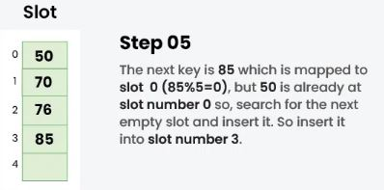
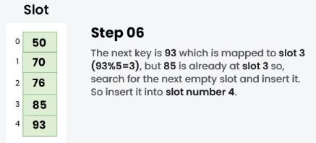

Slide 66
Quadratic Probing
The distance between subsequent probes or entry slots is the only difference between linear and quadratic probing.
You must begin traversing until you find an available hashed index slot for an entry record if the slot is already taken.
By adding each succeeding value of any arbitrary polynomial in the original hashed index, the distance between slots is determined.

Slide 67
index = index % hashTableSize
index = ( hash(n) % T)
(hash(n) + 1 x 1) % T
(hash(n) + 2 x 2) % T
(hash(n) + 3 x 3) % T … and so on
Example: Let us consider table Size = 7, hash function as Hash(x) = x % 7 and collision resolution strategy to be f(i) = i² .
Insert = 22, 30, and 50.

Slide 68
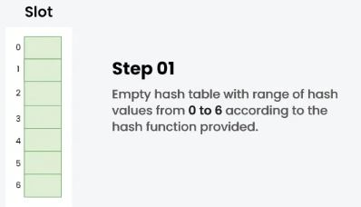
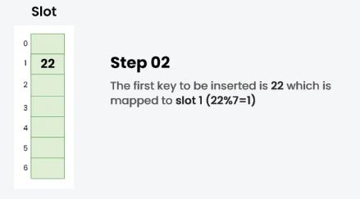
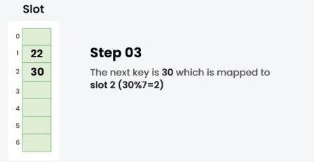
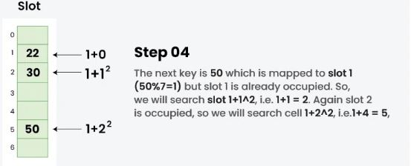

Slide 69
Double-Hashing
The time between probes is determined by yet another hash function.
Double hashing is an optimized technique for decreasing clustering.
The increments for the probing sequence are computed using an extra hash function.
(first hash(key) + i * secondHash(key)) % size of the table
index = hash(x) % S
(hash(x) + 1*hash2(x)) % S
(hash(x) + 2*hash2(x)) % S
(hash(x) + 3*hash2(x)) % S … and so on

Slide 70
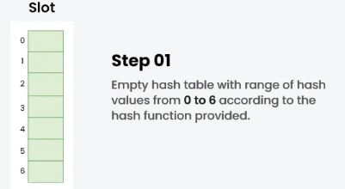
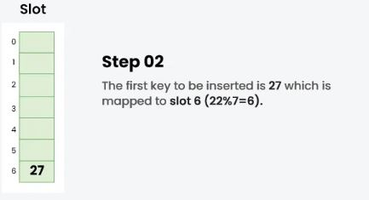
Example: Insert the keys 27, 43, 692, 72 into the Hash Table of size 7. where first hash-function is h1​(k) = k mod 7 and second hash-function is h2(k) = 1 + (k mod 5)

Slide 71
